Slide 1

Department of Information Technology NBA Accredited
A.P. Shah Institute of Technology
G.B.Road,Kasarvadavli, Thane(W), Mumbai-400615
UNIVERSITY OF MUMBAI
Academic Year 2020-2021

Slide 2
A Project Report on Depression Detection System –(Baymax) Submitted in partial full fillment of the degree of Bachelor of Engineering(Sem-8) in INFORMATION TECHNOLOGY By Rupesh Prasad(14104010) Nikhil Sonawane(16204010) Rajesh Kumar Soni(16104062) Under the Guidance of Prof. Apeksha Mohite

Slide 3
1.Project Conception and Initiation

Slide 4
1.1 Abstract
Artificial intelligence (AI) technologies and techniques have useful purposes in every domain of mental health care including clinical decision-making, treatments, assessment, self-care, mental health care management and more. Recent technological innovations are highlighted to demonstrate capabilities and opportunities. This project involves an AI based Expert System which can significantly contribute to improving mental health of an individual to lead a better life without any stress or melancholy. The expert system provides expert advice and therapy to overcome negative thoughts. This project can also help to reduce the number of suicides caused due to extreme depression.
This project is about virtual human conversation with the system to support user’s interaction within a mental health care context. It provides private online healthcare guidance and support where the app can serve the role of a clinician or a psychotherapist.

Slide 5
1.2 Objectives
To develop this android application motive is the detection of depression in an individual and giving them an online help to prevent it or to find a cure for their depression.
To develop a user friendly android application which enhances better graphical user interface that will help a user to interact in a proper way which will help us to examine their problem.
To help the user an individual suffering or going through depression to lure him out of it.

Slide 6
1.3 Literature Review
Paper Title : Releasing Stress Using Music Mood Application: DeMuse
Authors: Aslina Baharum1, Tan Wei Seong1, Nurul Hidayah Mat Zain2, Nurhafizah
Moziyana Mohd Yusop3, Muhammad Omar4, Nordaliela Mohd. Rusli
Publication details : Universiti Malaysia Sabah, 88400 Kota Kinabalu, Sabah, Malaysia
2017.
Findings: A content-based analysis was conducted in order to obtain the features that
are valuable enough as the properties usage in the development of prototype. In this content
analysis, a number of Music, which are “Relax Lite: Stress Relief”, “Calm”, “Relax & Rest
Guided Meditations”, “MindShift”, and “Pacifica: Stress & Anxiety”.
Advantages: Stress free Music.
Disadvantages: Chatbot was not provided and Fuzzy Logic was not provided only music was
Introduced.

Slide 7
1.3 Literature Review
Paper Title : Comparison of read and spontaneous speech in case of Automatic Detection of
Depression
Authors: Gábor Kiss, Klára Vicsi
Publication details : Department of Telecommunications and Media Informatics Budapest Universityof Technology and Economics Budapest, Hungary, 2017
Findings: Speech samples were collected from healthy and depressed subjects in quiet environmentwith head microphone. The recordings were recorded at 44,1 kHz with 16-bit sample rate. Two types of speech sample were recorded from each subject, read speech: a short folk tale “The North Wind and the Sun” and spontaneous speech: dialogue between the examined subject and interviewer, both in Hungarian language. A total of 73 subjects were recorded, 42 females and 31 males. From the 73 subject 48 subjects were diagnosed with depression, 30 females and 18 males, and 25 subjects were healthy, 12 females and 13 males
Advantages: Psychological Status Monitoring by G. Kiss, K. Vicsi • Comparison of read and spontaneous speech in case of Automatic Detection of Depression Computerized Analysis of Language phenomena (COALA) (AO-11-Concordia).
Disadvantages: Chatbot was not provided and Fuzzy Logic was not provided

Slide 8
1.3 Literature Review
Paper Title : Machine Learning Techniques for Stress Prediction in Working Employees
Authors: ADITYA VIVEK THOTA, A DHARUN
Publication details : SRINIVASULU REDDY Assistant Professor, Machine Learning and Data Analytics Lab, Department of Computer Applications, National Institute of Technology, Trichy
Findings: This is highly effective in healthcare as there is enormous amount of data and if this is properly fed to an intelligent system and trained accordingly, the resulting prediction model will be unparalleled and free from human errors and reduce the time required for diagnostics. Hence, the responses of the OSMI 2017 dataset were used to train the following ML models that are previously tested in healthcare based classification problems
Advantages: Motivational thoughts according to there requirements.
Galvanic Skin Response Disadvantages: Chatbot was not provided and Fuzzy Logic was not provided, for only office people.

Slide 9
1.3 Literature Review
Paper Title : Workplace Stress Detection Approaches
Authors: Sami Elzeiny, Marwa Qaraqe
Publication details : College of Science and Engineering Hamad Bin Khalifa University Doha, Qatar
Findings: Define the main goal and strategy of the organization.Construct a clear leadership structure and hierarchy.Limit working shifts to 12 hours maximum with overlapbetween shift to ensure briefing the following staff.Provide training, communication tools such as phones,intranet portals.Rotate employees between high-, mid-, low-stress tasks,and encourage breaks and vacations.Consider flexible working scheme including part time job,distance working, or sharing job
Advantages: Electrocardiography (ECG),Electroencephalography (EEG),Electrodermal activity(EDA).
Galvanic Skin Response Disadvantages: Chatbot was not provided and Fuzzy Logic was not provided, for only office people.

Slide 10
1.3 Literature Review
Paper Title : Distributed Grating Sensor Stress Data Acquisition and Management System
Authors: Zhenhai Mu , Lizhen Jiang
Publication details : Guilin University of Aerospace Technology ,Guilin,541004,China
Findings: As a popular measuring tool, grating sensor should be used.The range of application is more and more extensive. The advantages of high-precision data measured make it a promising development prospect at home and abroad. At the same time, the system design of this subject needs to combine hardware and software.
Advantages: Detect The level of stress
Galvanic Skin Response Disadvantages: Chatbot was not provided and Fuzzy Logic was not provided, Only level is shown.

Slide 11
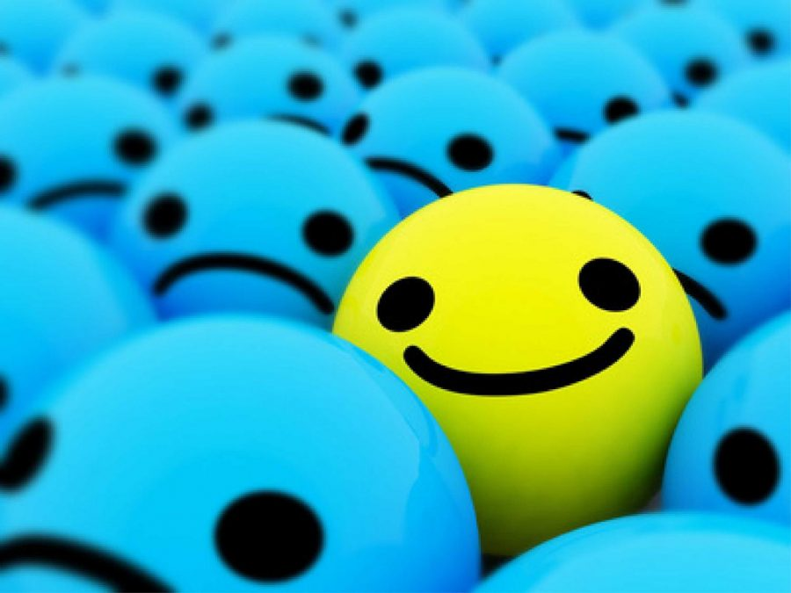
1.4 Problem Definition
Baymax is an AI based application, which serves as a companion and is capable of understanding people’s emotions.
It helps to deal with depression and stress by guiding the person to think rationally and deal with any situation in an optimistic manner.
Baymax is capable of analyzing depression levels and provides psychotherapy.
This application should immediately send an alert to the user’s acquaintance when it identifies that the user is going to take a fatal decision.
The Baymax software must take care of all the cases that will be encountered during conversation.

Slide 12
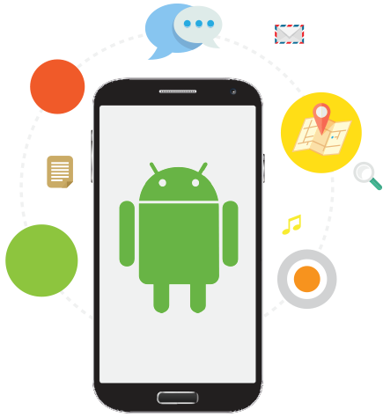
1.5 Scope
The aim at detecting the depression level of a certain age criteria. From the result, it can be clearly stated that people differ from the state of health to do so the person's information is kept in database and each individual is provided with a different level of treatment.
Given the current versatility and variety of development option for mobile application, the key is to determine what platform will best align with your business problems and goals. Mobile application are a powerful tool for connecting with the consumer, businesses and users, and their functionality and value is only increasing as the world continues to more towards mobility.
As the features where compared with some other significance features, and as a result it was stated that few project where dealing only till the depression detection. As this application deals with the detection as well as to help to decreased the level of depression.

Slide 13
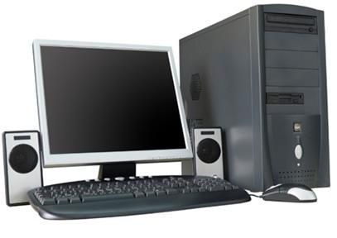
1.6 Technology stack
Developer Side
Hardware
Working Computer with 500GB Hard Drive and 4GB RAM
Keyboard, Mouse
Software
Kotlin: Using Android studio.
Database: Firebase
Rule Engine: DROOLS.

Slide 14
1.6 Technology stack
User’s Side
Software
RAM 2gb +
Processor- MediaTek Helio P10
Hardware
Android Phone (Version 5.0 Lollipop)

Slide 15
1.7 Benefits for environment & Society
It Helps people to keep them out of stress and Anxiety.
It Boost confidence level in patients and keep them out from stress. Energize and prompt you to take action.
Our Application make you see the bright side of life, motivate, and give hope for a better future.
Our Application inspire to positive thinking and taking positive action.
The Power Of Smile.
Live Doctor support.

Slide 16
2. Project Design

Slide 17
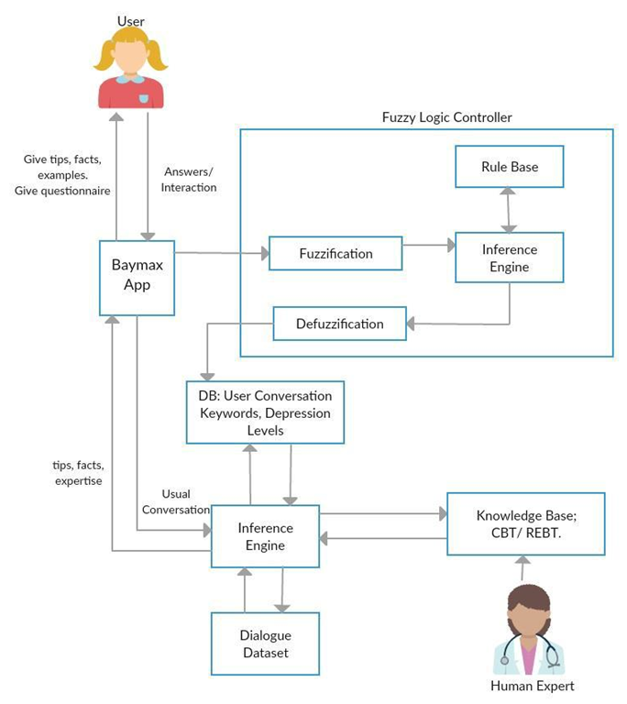
2.1 Proposed System Architecture

Slide 18
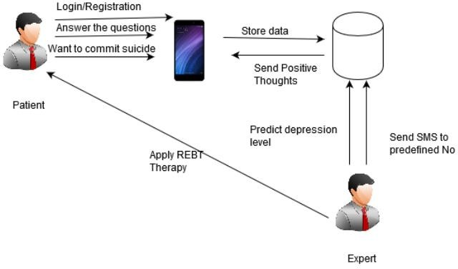
2.2 Design(Flow Of Modules)

Slide 19
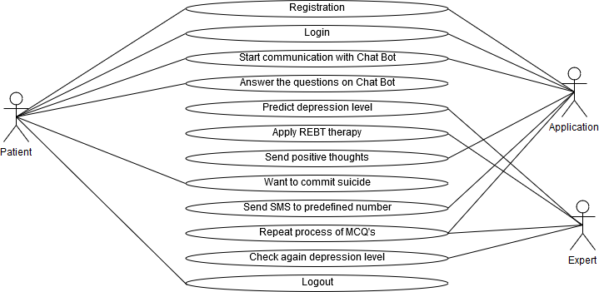
2.3 Description Of Use Case
Patient, Application, Expert acts as an actor. here patient will give input to the application. Patient and Expert will communicate through application.

Slide 20
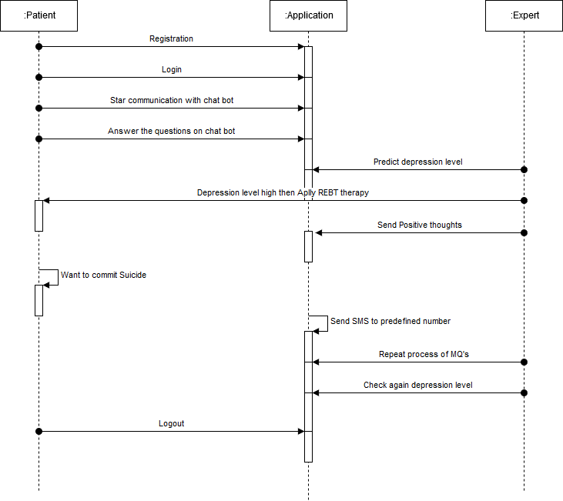
2.4 Activity diagram
Patient, Application, Expert. Patient can register and login to the application and can communicate with chat bot. Expert predict depression level and if high use REBT therapy, send SMS to patient.

Slide 21
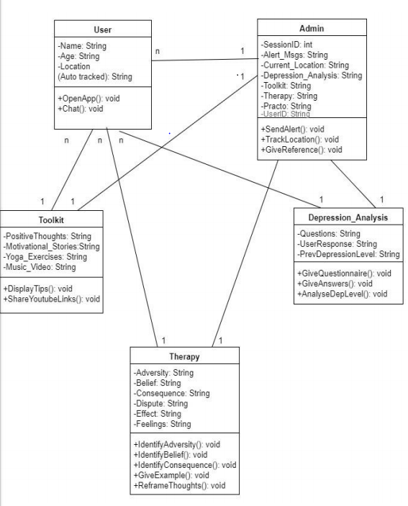
2.5 Class Diagram
A class diagram is a type of static structure diagram that describes the structure of a system. Even their attributes, operations and relationships. Depression analysis will analysis the depression.
Here User class represent the basic information of user. Toolkit class represents positive thoughts, yoga tips etc. Therapy class represents consequences and feelings.

Slide 22
3. Implementation

Slide 23
3. Implementation
Our system is an depression based Android Application which we have designed in such a way so as to make it user friendly and interactive. In this we have added various features such as chat bot so as to interact with the user. Also the user can create his own personalized account by creating a profile for which he needs to register himself first and then sign in to his account so as to maintain his data and records. A questionnaire is taken to analyse the level of depression faced by an individual. The result of the test are displayed just after the test and depending upon the level of depression the solution is provided. There are motivational videos and also motivational quotes along with meditation and yoga tips.

Slide 24
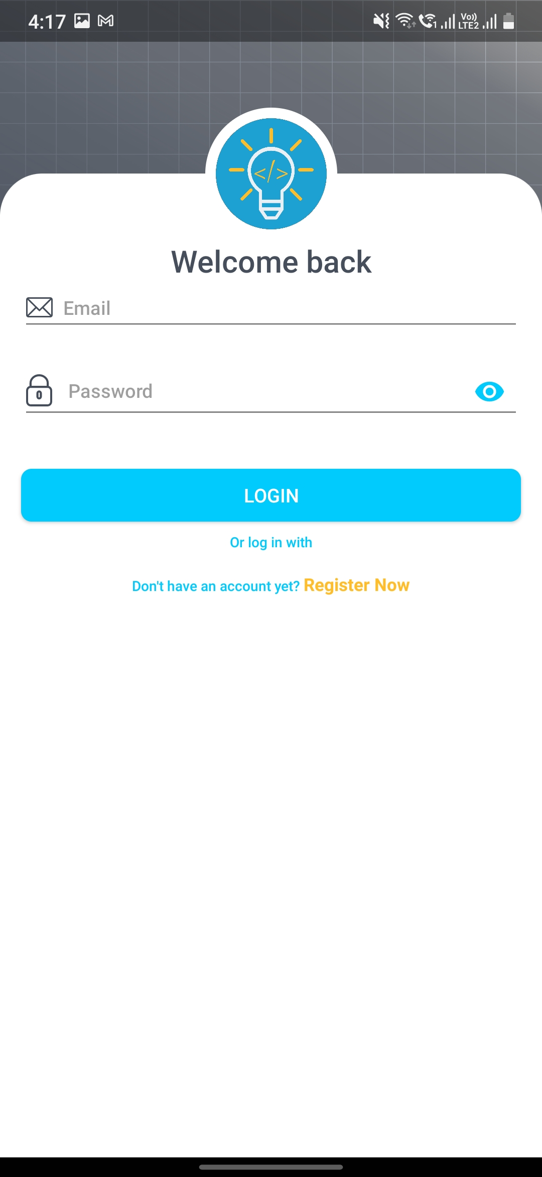
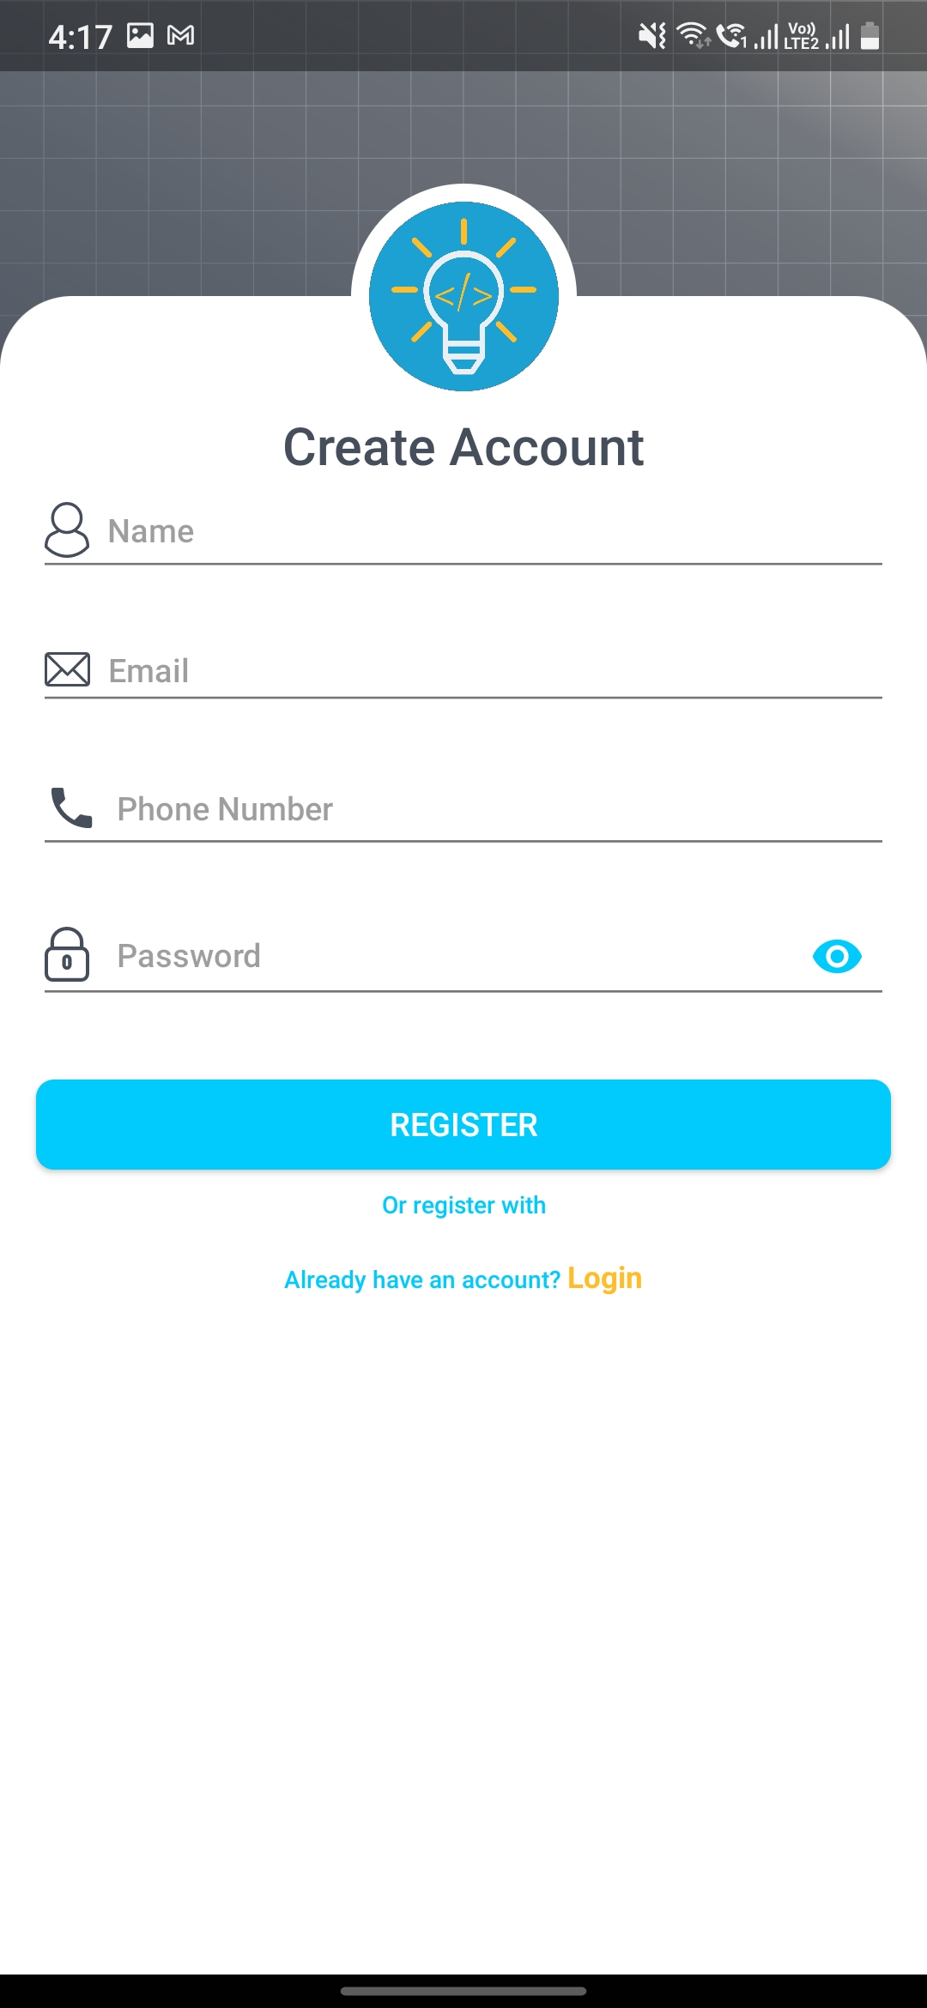
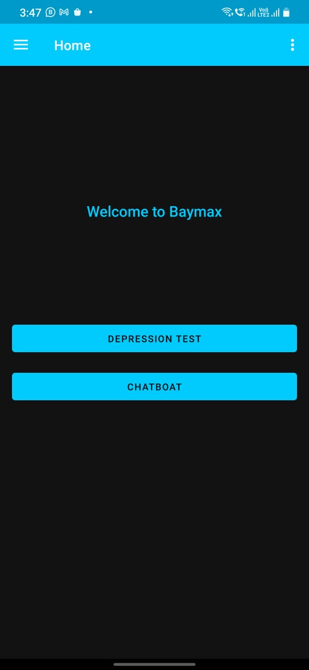
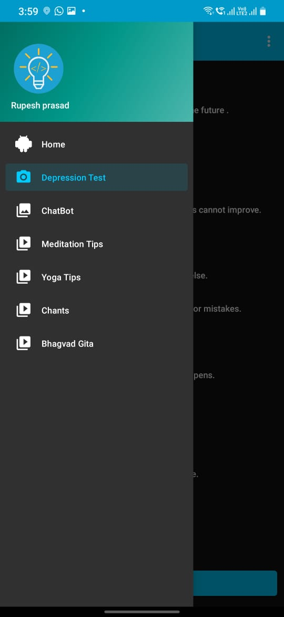
Login
Registration
Home Page
More Options

Slide 25
4. Testing

Slide 26
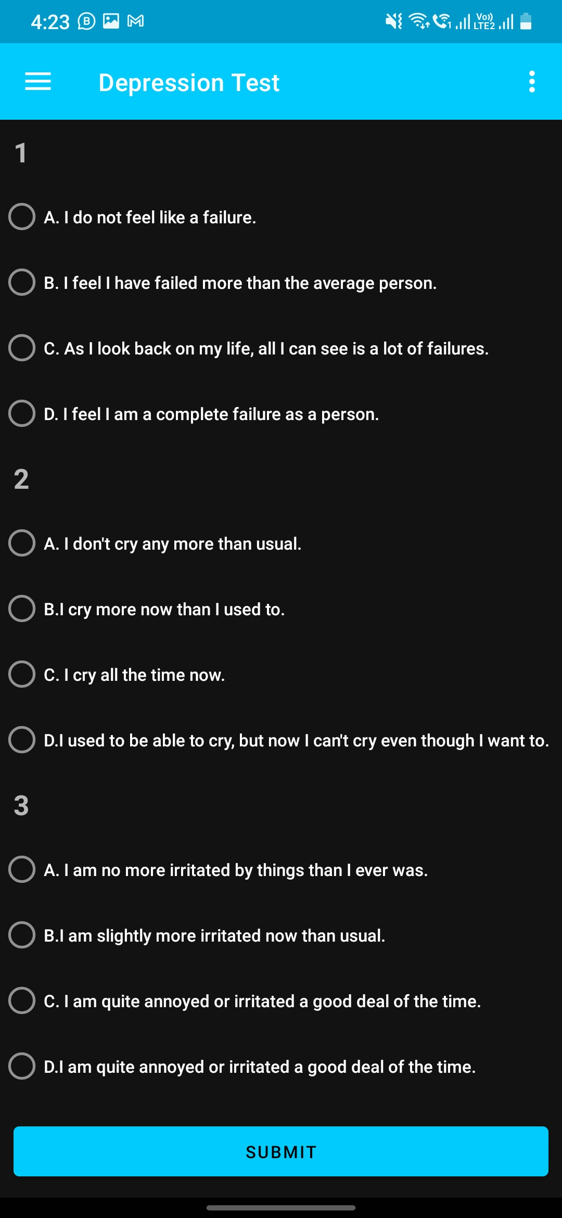
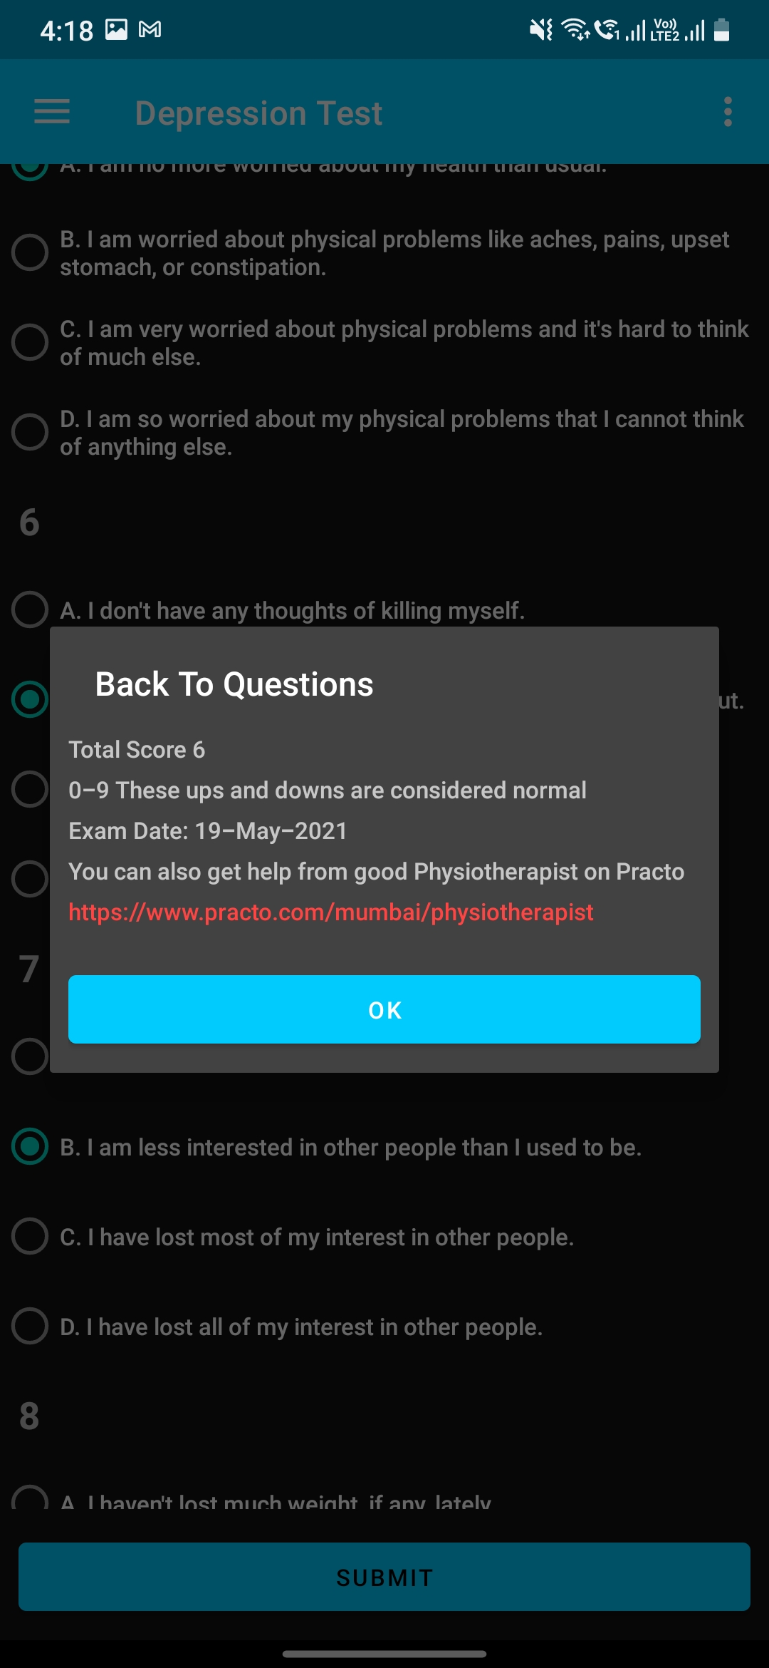
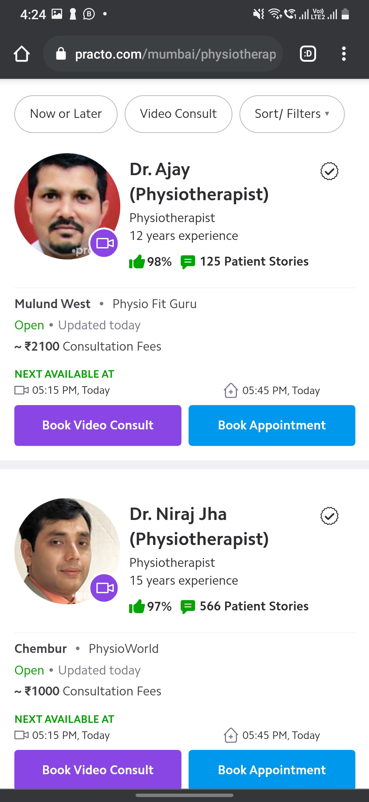
Test Will Start With MCQ’s
View Marks and
depression level
Expert Advice

Slide 27
5. Result

Slide 28
Result
As the system provide the right tools for discussion, problem solving it must be made sure that the system is reliable in its operations and for securing the sensitive details.
If there is extensive damage to a wide portion of the database due to catastrophic failure, such as a disk crash, the recovery method restores a past copy of the database that was backed up to archival storage (typically tape) and reconstructs a more current state by reapplying or redoing the operations of committed transactions from the backed up log, up to the time of failure.
If the internet service gets disrupted while sending information to the server, the information can be sent again for verification. Only the administrator can do modifications in the database. No other unauthorized user is allowed to access the database.

Slide 29
6. Conclusion & Future Scope

Slide 30
Future Scope
The aims at detecting the depression level of a certain age criteria. From the result, it can be clearly stated that people differ from the state of health to do so the person's information is kept in database and each individual is provided with a different level of treatment.
Given the current versatility and variety of development option for mobile application, the key is to determine what platform will best align with your business problems and goals. Mobile application are a powerful tool for connecting with the consumer, businesses and users, and their functionality and value is only increasing as the world continues to more towards mobility.
As the features where compared with some other significance features, and as a result it was stated that few project where dealing only till the depression detection. As this paper deals with the detection as well as to help to decreased the level of depression.
In the experiment presented in this paper, a depression detection approach based REBT (Rational Emotive Behavioural Therapy) , In future work the project can be assessed with a SMS or location detection of end user.
This application should immediately send an alert to the user’s acquaintance when it identifies that the user is going to take a fatal decision.

Slide 31
Conclusion
Depression detection system aims on helping each & every individual to overcome his insecurities regarding the mental stress. This application mainly focus on how the user is feeling by asking some set of questions which would be further estimated in level of stress he is going through. To avail this application user need to install a application in their mobile phones. The application is design in such a way that if the algorithm finds out that person is suffering from severe level of stress then some different kind of help is offered for mild to moderate mostly in some motivational video or text form. For severe cases app drive patient to online consulting platform practo. This application will overcome the unspoken culture of depression in India.

Slide 32
References
Sami Elzeiny, Marwa Qaraqe(Blueprint to Workplace Stress Detection Approaches) 2018.
Comparison of read and spontaneous speech in case of Automatic Detection of Depression(Gábor Kiss, Klára Vicsi) 2017.
Aslina Baharum1, Tan Wei Seong1, Nurul Hidayah Mat Zain2, Nurhafizah Moziyana Mohd Yusop3, Muhammad Omar4, Nordaliela Mohd. Rusli (Releasing Stress Using Music Mood Application: DeMuse) 2017.
ADITYA VIVEK THOTA, A DHARUN (Machine Learning Techniques for Stress Prediction in Working Employees ) 2018.
Zhenhai Mu , Lizhen Jiang (Distributed Grating Sensor Stress Data Acquisition and Management System )2019.
A. Wood, G. Virone, T. Doan, Q. Cao, and L. Selavo. ALARM-NET: Wirelesssensor networks for assisted-living and residential monitoring. Technical report, University of Virginia, Jan 2006.
O. A. P. Ltd. Optimism apps, 2011 [8] M. Hadzic, F. Hadzic, and T. Dillon. Mining a patient data: towards better treatmentstrategies for depression. In Functional Informatics and Personalized Medicine (IJFIPM),volume 3, 2010.

Slide 33
References
T. Sheeran. Viability and impact of telehealth-based depression care in home care.Technical report, Rhode Island Hospital, 2010.
M. Sung, C. D. Marci, and A. Pentland. Objective physiological and behavioral mea-sures for identifying and tracking depression state in clinically depressed patients. Technicalreport, MIT, 2005.
G´abor Kiss, Kl´ara Vicsi,Department of Telecommunications and Media Informatics Budapest University of Technology and Economics Budapest, Hungary, 2017.
Website Used:
Chatbot, https://dialogflow.com/
Meditation tips, https://chopra.com/articles/learn-to-meditate-in-6-easy-steps.
Chants, https://wanderlust.com/journal/6-step-guide-start-chanting-practice.
Yoga Tips, https://www.realbuzz.com/articles-interests/fitness/article/top-tips-foryoga-beginners/
Bhagvad Gite Yoga, https://iskcondwarka.org/blogs/the-eight-steps-of-hatha-yogaand-bhagavad-gita.

Slide 34
Thank You

